Slide 1

Level 5 Data Engineer Module 6 Topic 1
Introduction to Data Collection and Ingestion
L5 Data Engineer Higher Apprenticeship
Module 6 / 12 (“Data Collection and Ingestion pt. 1”)
Topic 1 / 4
Notes:
Instructor notes:
At this stage of your journey with Data Engineering, you have gained insight into data basics, databases, programming, networks and cloud. Now it is time to look at data collection and ingestion, as this area provides the missing piece to building successful data products and services.
When you start a new data project, you need data.
Even if you have it at hand, it may not be in the right shape or form. And even if you do find the right dataset that does seem to fulfil your project’s requirements, it may just be a single snapshot of data that you have - so then you have to think about how to refresh it and keep it continually up to date.
Data is never perfect for your analysis right off the bat, and getting the right data requires a combination of sourcing, cleansing and automation skills and knowledge. It is, therefore, essential that you become familiar with those skills and knowledge.

Slide 2




Ice breaker: Discussion
A bit of fun to start…
How do you collect data about yourself?
Do you track your daily steps using a fitness app?
Do you track how long you spend on social media or streaming services?
If you could collect data on any topic in the world, what would it be and why?
Submit your responses to the chat or turn on your microphone
Notes:
Instructor Guidance: Facilitate discussion of the ice breaker on-screen – the idea being to put everyone at ease and encourage greater participation in the session.

Slide 3

Case study
Amazon’s supply chain optimisation
Objective: Amazon aimed to enhance inventory management and improve delivery times through data-driven decision-making.
Challenges: Managing a complex supply chain with diverse products and fluctuating demand.
Data Collection: Gathering data from sales, inventory, customer interactions, and logistics.
Implementation: Using predictive analytics to forecast demand and optimize inventory levels.
Results: Achieved significant cost savings, faster delivery times, and improved customer satisfaction.
Notes:
Instructor guidance: Provide an overview of the attention-grabbing case study shown on-screen using the notes below.
Objective:
Amazon aimed to enhance its inventory management and improve delivery times through data-driven decision-making.
Challenges:
The complexity of Amazon’s supply chain involves numerous stages, from sourcing products to delivering them to customers. They needed to manage different types of products, fluctuating demand, and the commitment to fast and efficient delivery.
Data Collection and Ingestion:
Amazon implemented a robust data collection and ingestion strategy, gathering data from various sources:
Sales Data: Collected from their e-commerce platform.
Inventory Data: From warehouses and fulfillment centers.
Customer Data: Including purchase history and preferences.
Logistics Data: From transportation and delivery networks.
Implementation:
Using predictive analytics, Amazon analyzed historical data, current market trends, and seasonality to forecast future demand accurately. This helped them optimize inventory levels, preventing both stockouts and overstock situations.
Results:
Cost Savings: By minimizing excess inventory and improving warehouse efficiency, Amazon achieved significant cost savings.
Improved Delivery Times: Streamlined inventory management contributed to faster order fulfillment, reducing delivery times and enhancing customer satisfaction.
Enhanced Customer Experience: By ensuring products were available when customers wanted them, Amazon improved overall customer satisfaction and loyalty.
Key Takeaways:
Data-Driven Decision-Making: Leveraging data to make informed decisions is crucial for optimizing supply chain operations.
Dynamic Inventory Optimization: Using predictive analytics allows for quick adjustments to changing market conditions and consumer demands.
Customer-Centric Logistics: Focusing on reducing delivery times and improving logistics enhances customer satisfaction and loyalty.
Investment in Technology: Continuous investment in advanced technologies like AI and machine learning is essential for maintaining a competitive edge.

Slide 4

Knowledge check poll
Your company wants to integrate data from various sources into a central data warehouse.
How would you approach the data ingestion process to ensure smooth integration and high data quality?
Ingest data without any preprocessing.
ETL (Extract, Transform, Load) processes to clean and transform data before loading it into the warehouse.
Load all data directly into the warehouse and clean it later.
Only ingest data from structured sources.
Submit your responses to the chat!
Feedback: B – ETL processes help in cleaning and transforming data, ensuring that only high-quality data is loaded into the data warehouse, which facilitates better analysis and decision-making.
Notes:
Instructor guidance: Facilitate completion of the knowledge check poll shown on-screen. This has been selected for a knowledge check poll because it is a foundational concept for this topic. Click to display feedback.
Instructor notes:
ETL processes help in cleaning and transforming data, ensuring that only high-quality data is loaded into the data warehouse, which facilitates better analysis and decision-making.

Slide 5

Session aim and objectives
Completion of this topic supports the following outcomes:
Justify the importance of automation in data collection and ingestion
Evaluate common data cleaning techniques
Recognise the steps required to pre-process data for machine learning purposes
Demonstrate practical data collection and ingestion skills

Slide 6
Two content slides 1
E-learning Recap

Slide 7

Recap discussion
Can you remember the difference between data collection and ingestion?
Can you recall key approaches to collecting data.
Can you remember the main approaches for data ingestion?
What are the common types of dirty data?
Notes:
Instructor guidance:
The aim of this slide is to check how much students understood from the e-learning.

Slide 8

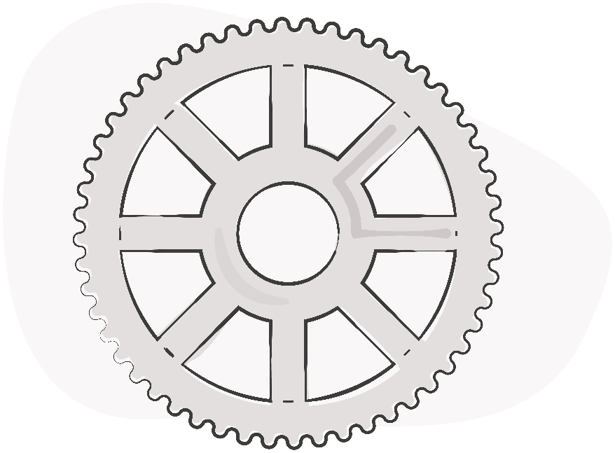
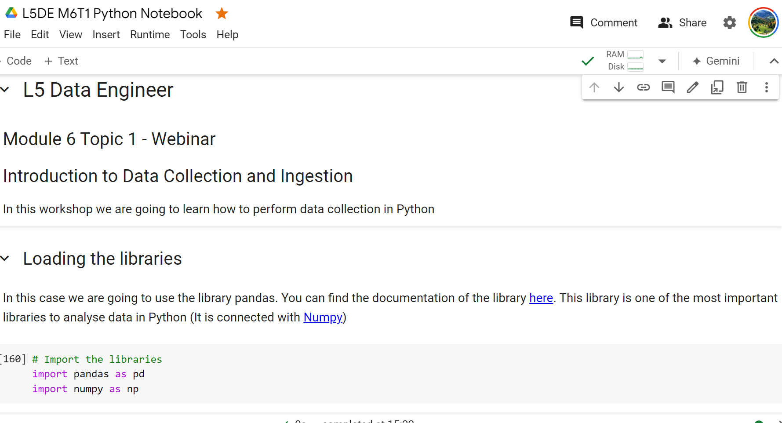
Practical application
Your tutor will now walk you through the Collab notebook.
Notes:
Instructor guidance: Facilitate and lead completion of the activity shown on-screen.

Slide 9

Things we learned from the code walkthrough
We will now recap the following functions we learned from the Python code walkthrough:
DataFrame.T
DataFrame.reset_index()
DataFrame.melt()
DataFrame.rename()
DataFrame.to_numeric()
DataFrame.unique()
DataFrame.apply()
Lambda functions

Slide 10
Lambda functions
Anonymous functions – function without a name
We use lambda functions when we require a nameless function for a short period of time.
Python Lambda syntax:
lambda arguments : expression
Example:
lambda_cube = lambda y: y*y*y

Slide 11
Using pandas documentation
pandas documentation — pandas 2.2.2 documentation
API reference
This page gives an overview of all public pandas objects, functions and methods. All classes and functions exposed in pandas.* namespace are public.
Most important webpage:
https://pandas.pydata.org/docs/reference/api/pandas.DataFrame.html
User Guide
User Guide — pandas 2.2.2 documentation (pydata.org)
The User Guide covers all of pandas by topic area. Each of the subsections introduces a topic (such as “working with missing data”), and discusses how pandas approaches the problem, with many examples throughout.

Slide 12
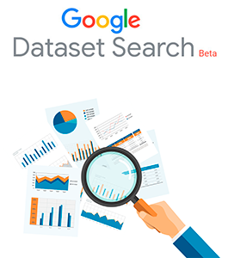

Recap: Data sourcing

Slide 13
Practical considerations when collecting data
Identify Stakeholder Requirements:
Engage with stakeholders from different parts of the business to understand their data needs.
Define specific business objectives that the data should help achieve.
Data Identification and Assessment:
Determine the type of data required to meet the objectives.
Assess the volume, variety, velocity, and veracity of the data to understand the complexity of data handling.
System Selection (SQL/NoSQL/Data Lake/Warehouse/Cluster):
SQL Databases: Best for structured data with complex queries and transactions.
NoSQL Databases: Suitable for unstructured data, providing flexibility in terms of schema and scaling.
Data Lakes: Ideal for storing massive amounts of raw data in its native format. Useful for big data applications.
Data Warehouses: Optimal for analytics and business intelligence; structured for SQL queries.
Data Clusters: Useful for processing large datasets across distributed computing environments.
Notes:
Click to display all content.

Slide 14
More practical considerations
Data Acquisition Strategy:
Plan how to acquire data (e.g., APIs, web scraping, IoT devices, third-party datasets).
Establish data quality checks and initial processing steps.
Data Management Plan:
Define the data governance framework (access controls, audit trails, compliance).
Plan data maintenance, updates, and lifecycle management.
Set up data backup and disaster recovery protocols.
Implementation and Integration:
Integrate the chosen data systems with existing IT infrastructure.
Develop or customise software for data ingestion, processing, and analytics.
Monitoring and Evaluation:
Continuously monitor data quality and system performance.
Evaluate the system’s ability to meet business needs and make adjustments as necessary.
Notes:
Click to display all content.

Slide 15
Most Common Folder Structures
For data file imports…
Landing Area: Raw data files are first ingested here; data is unprocessed and in its original format.
Staging Area: Data is moved here from the landing area for initial processing and cleaning.
Ingestion Layer: This is where data is transformed and loaded into more structured formats suitable for analysis.
Archived Data Folders: After data has been analysed and is no longer immediately needed, it is moved to this area for long-term storage.

Slide 16
Case study: E-commerce
Objective: Enhance customer experience through personalised marketing and improve inventory management.
Stakeholder Requirements:
Marketing wants customer demographic and behaviour data.
Operations need inventory and sales data to optimise stock levels.
Data Assessment:
Customer data includes structured data (age, location) and unstructured data (social media activity).
Inventory data is highly structured with clear attributes (SKU, quantity, location).
System Selection:
Customer Data: NoSQL database for flexibility with unstructured data and scalability.
Inventory Data: SQL database for complex queries and transactional integrity.
Analytics: Data warehouse to integrate various data for BI tools.

Slide 17
Case study continued
Data Ingestion:
Customer data through online forms, social media APIs, and loyalty programs.
Inventory data from point-of-sale systems and supplier databases.
Data Management:
Data governance policies in place to protect customer privacy.
Regular updates to inventory data with real-time processing for dynamic decision-making.
Implementation:
Deploy MongoDB for NoSQL needs; use PostgreSQL for SQL requirements.
Integrate with a cloud-based data warehouse (e.g., Amazon Redshift).
Monitoring:
Use dashboards to track key metrics like customer engagement and inventory turnover.
Regularly review system performance and stakeholder satisfaction.

Slide 18
Licensing and tracking data usage
Understand Data Licensing: Ensure clarity on the terms of use, restrictions, and obligations associated with the data. This includes understanding whether the data can be shared, modified, or needs to be kept secure.
Document and Track Data Usage: Implement a system to track how data is being used within your organisation. This helps in auditing and ensuring compliance with licensing agreements.
Negotiating Licenses: Work with legal teams to negotiate data licenses that align with your business needs and risk management strategies.
Resolve Licensing Issues: Establish a clear process for resolving disputes over data usage, which may include mediation or legal actions if necessary.
Training and Awareness: Regular training sessions for employees on the importance of compliance with data licensing terms to avoid legal issues.

Slide 19

Key Learning Summary
The key takeaways from this session are as follows:
Automation in Data Collection and Ingestion: Automation reduces errors and increases efficiency in data handling.
Data Cleaning Techniques: Common techniques include removing duplicates, handling missing values, and standardising data formats.
Pre-Processing for Machine Learning: Pre-processing steps include normalisation, encoding categorical variables, and feature scaling.
Practical Skills: Hands-on experience with tools like Python and pandas for data manipulation and analysis is crucial.
Notes:
Instructor Guidance: Provide an overview of the key learning summary points from this lesson. Click to display all bullets.

Slide 20

Thank you
Do you have any questions, comments, or feedback?

